Slide 1
Refining Processes

Slide 2
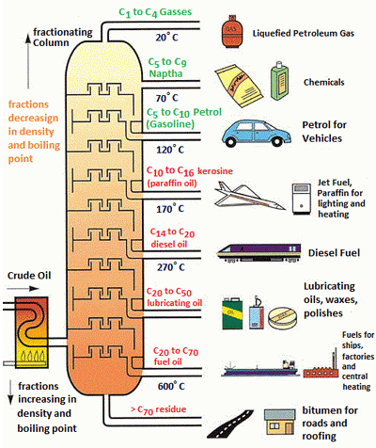
European Refining Overview
Crude Oil is a broad mix of hydrocarbons, which must be separated and refined prior to commercial use
Molecules range from very light to very heavy
The first process of any refinery is the fractionation of crude into different fractions by distillation
The fractions are characterized by their boiling temperatures
Refineries exploit the different properties of each fraction to produce finished products

Slide 3
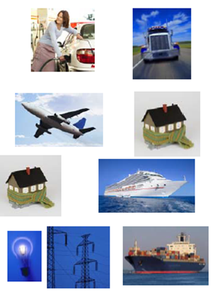
European Refining Overview
Refined products must meet many quality specifications: legal and fit-for-use
Sulphur content
Combustion properties
Volatile organic compounds
Density
Gasoline / Diesel
Flash point
Freeze point
Water content
Jet / Kerosene
Sulphur content
Combustion properties
Cold Flow properties
Density
Other Gasoils
Sulphur content
Viscosity
Density
Heavy Fuel Oil

Slide 4
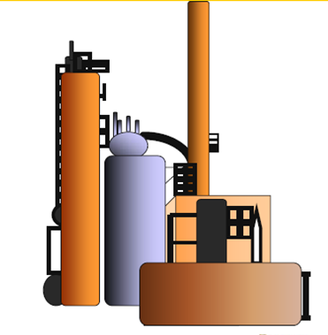
European Refining Overview
The processes used by refineries can be classified into four categories
Separation
Atmospheric distillation
Vacuum distillation
Absorption
Treating (quality improvement)
Catalytic Reforming
Isomerisation
Hydrotreating
Conversion
Catalytic cracking
Hydrocracking
Visbreaking
Coking
Transformation
Alkylation
Etherification

Slide 5
Demand Shifts Toward Lighter Oil Products
Share of liquid products
Notes:
Source: ExxonMobil 2018 Outlook for Energy

Slide 6
Simplified Fuels Refining
Virgin light ends
LPG
Naphtha
Atmospheric Pipestill – separation by boiling point
Hydrofining – sulfur removal via hydrogen addition
Reforming – increase gasoline octane, chemicals feed for aromatics
Vacuum Pipestill – separation by boiling point under a vacuum
Fluid Catalytic Cracking (FCC) – convert vacuum gas oil to clean products, primarily gasoline
Alkylation – upgrade light ends to high octane gasoline blending components
Hydrocracking – convert vacuum gasoil to clean products, primarily diesel
Coker – convert residual to lighter products and coke
Atmos.
Pipe-still
Naphtha Hydrofining
Reformer
Gasoline
Distillate Hydrofining
Jet Fuel/Kerosene
Crude
Oil
Distillate/Diesel
Fuel Oil
Vacuum Pipe-still
Gas Oil
Fluid Catalytic Cracking (FCC)
Cracked Light
Ends
Light Ends
Alkylation
Coker
Gasoline
Gas
Oil
VGO Hydrocracker
(HDC)
Jet Fuel/Diesel
Coke
Fuel Oil
Asphalt
Low Conversion Refinery
Additional Medium and High Conversion Processing
Additional High Conversion Processing

Slide 7
Hydroskimming Refinery
Naphtha (10%)
Jet Fuel (10%)
(30%)
(50%)

Slide 8
Vacuum Distillation Refinery
Naphtha (10%)
Jet Fuel (10%)
25%
20%
5%
30%
35%

Slide 9
Mogas Production

Slide 10
Naphtha Streams Before Mogas Processing
Steam Cracker

Slide 11
Catalytic Reforming
Steam Cracker

Slide 12
Isomerisation
Steam Cracker

Slide 13
Alkylation

Slide 14
Distillates Production

Slide 15
Hydroskimming Refinery

Slide 16
Vacuum distillation
Naphtha
Jet Fuel

Slide 17
Typical Gas Oil Conversion Refinery in Europe

Slide 18
Hydrocracking Refinery

Slide 19
Resid Conversion

Slide 20
Conversion Refinery
Naphtha
CONV

Slide 21
Residue Conversion Processes
Mild Resid conversion (thermal)
Visbreaking
Carbon Rejection Processes (thermal)
Delayed Coking
Fluid Coking/FLEXICOKING
Hydrogen Addition (Hydroconversion)
Residfiner
Other Fuel Oil Reduction Steps
Deasphalting
Partial Oxidation

Slide 22
Conversion Processes
Process | Catalyst | H2 | Feed | Carbon dispositioning
FCCU | Yes | No | VGO | CO-CO2
Hydrocracker | Yes | Yes | VGO | HC
Visbreaker | No | No | Resid | HC
Delayed Coker | No | No | Resid | Cokes
FXK | No | No | Resid | CO-CO2
De-asphalter | No | No | Resid | Asphalt
Residfiner | Yes | Yes | Resid | HC

Slide 23
Sulphur Reduction

Slide 24
Hydrotreaters in a High Conversion Refinery
Scanfiner

Slide 25
Back-Up

Slide 26
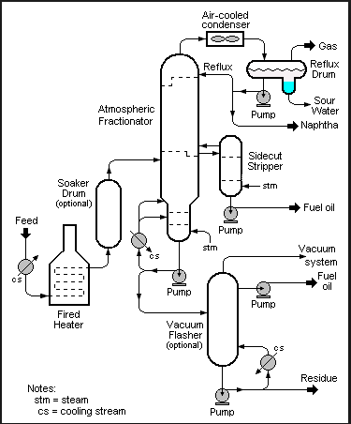
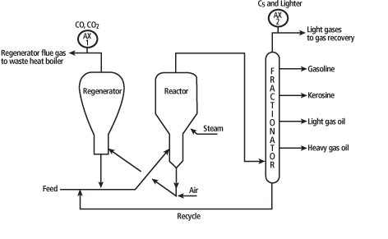
Back-up
Fluid Catalytic Cracking unit
Delayed Coker
Visbreaker

Slide 27
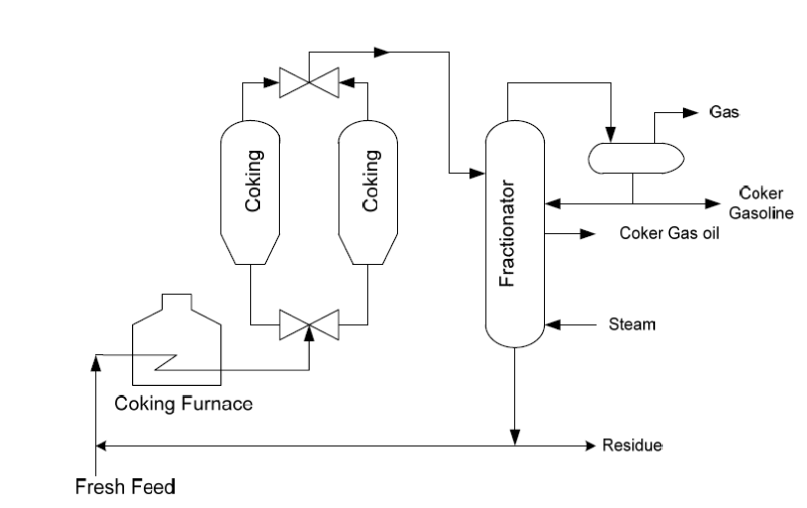
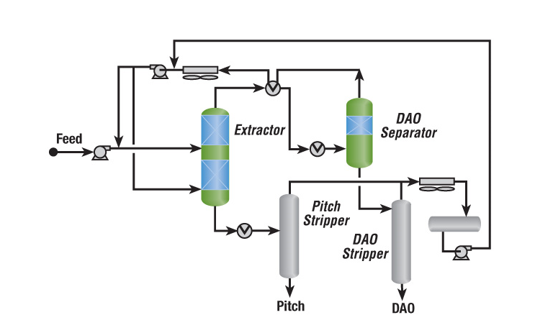
Back-up
Delayed Coker
Solvent Deasphalting unit

Slide 28
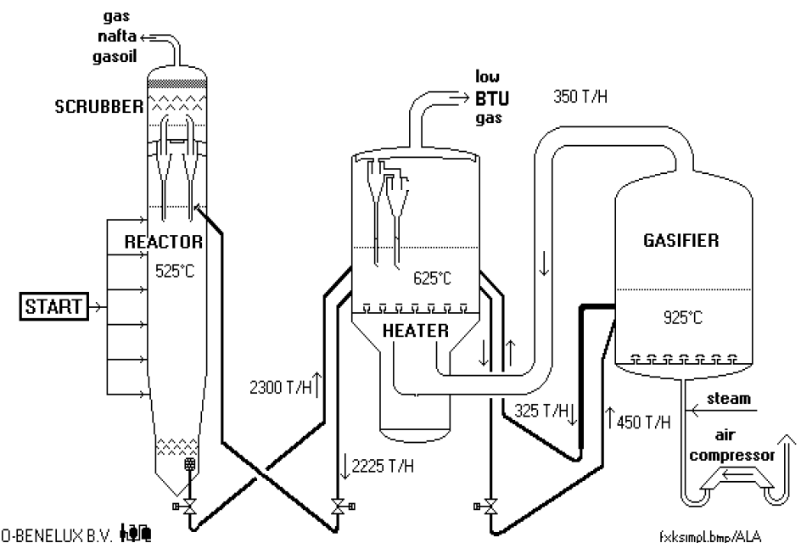
Back-up
Catalytic Cracking unit
Delayed Coker
Flexicoker

Slide 29
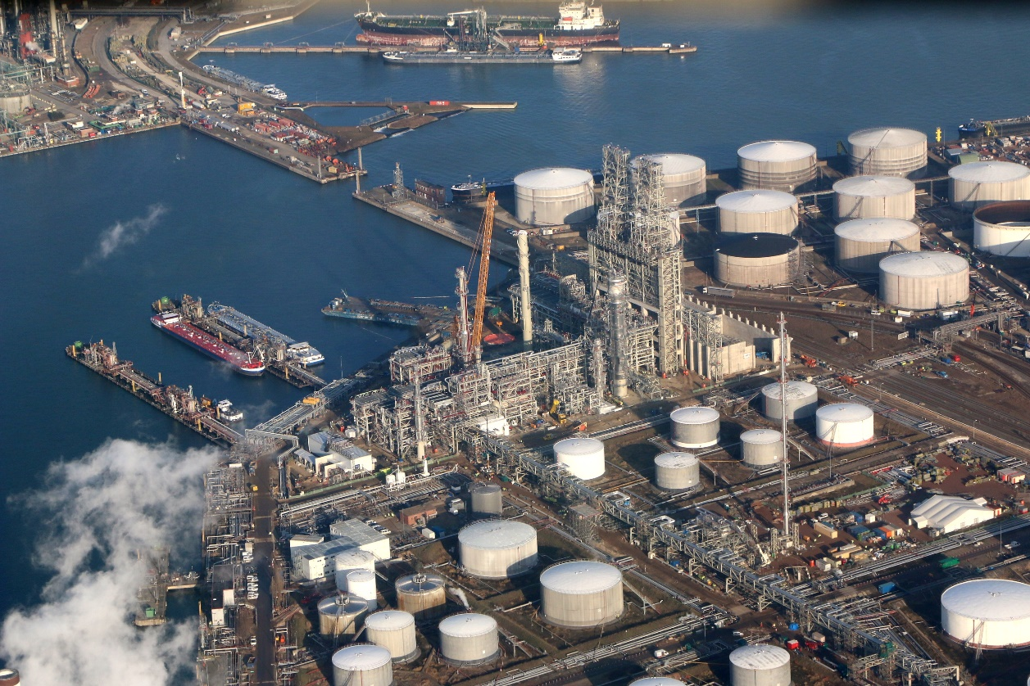
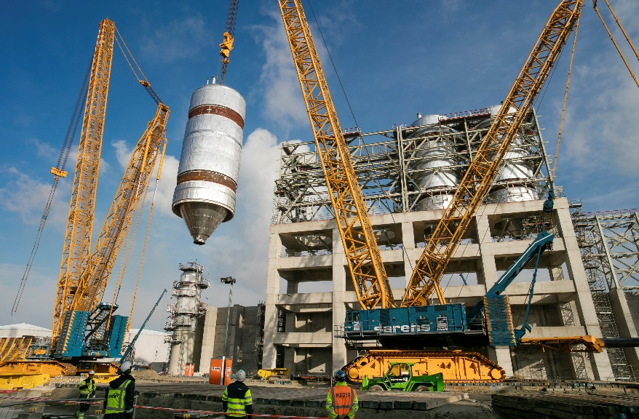
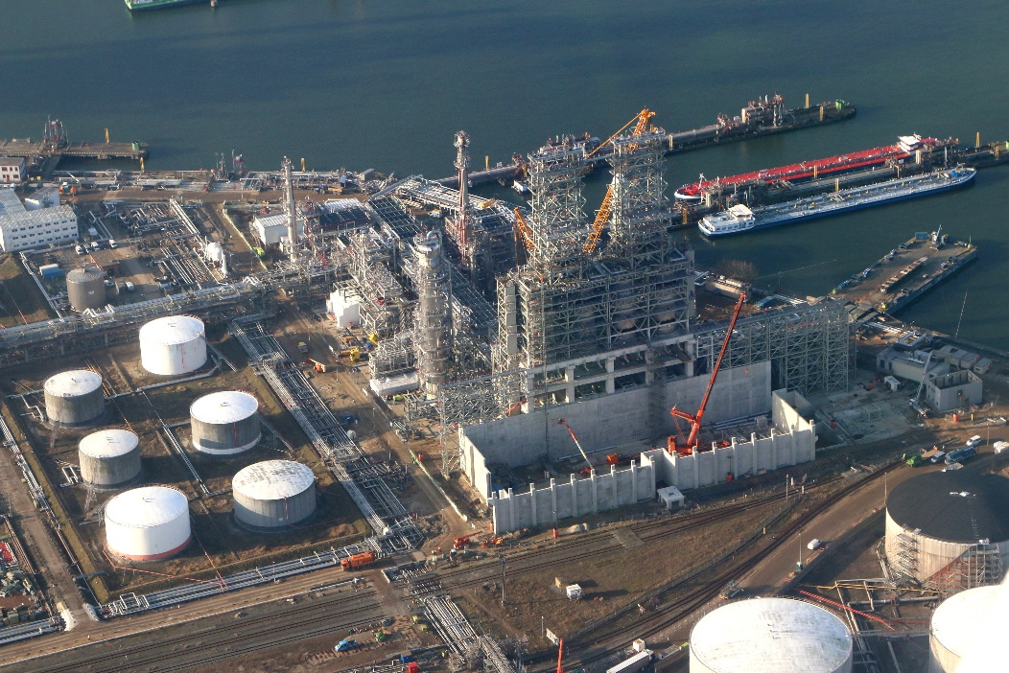
Back-up
Delayed Coker

Slide 30
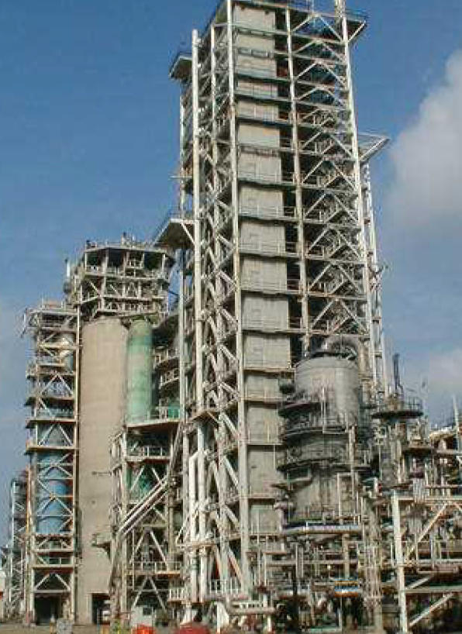
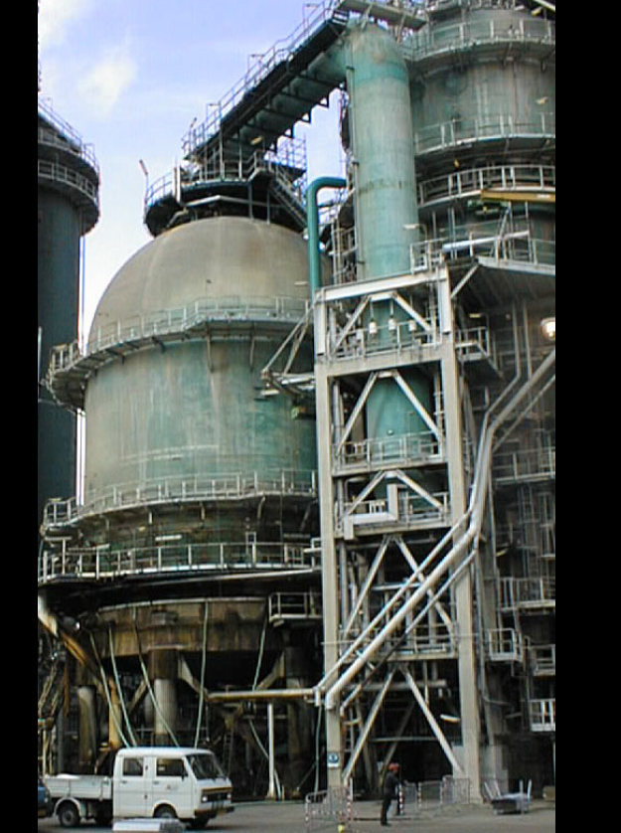
Rotterdam Flexicoker

